Slide 1
Introduction to Machine Learning – Evaluating Models
Dr. Ab Mosca (they/them)
Slides based off slides courtesy of Jordan Crouser (https://jcrouser.github.io/)

Slide 2
Plan for Today
Evaluating:
Regression
Classification
Bias-variance trade off
R demo time permitting

Slide 3
What we’ll cover in this class
Ch. 2: Statistical Learning Overview (today)
Ch. 3: Linear Regression
Ch. 4: Classification
Ch. 5: Resampling Methods
Ch. 6: Linear Model Selection
Ch. 7: Beyond Linearity
Ch. 8: Tree-Based Methods
Ch. 9: Support Vector Machines
Ch. 10: Unsupervised Learning
Notes:
Ch. 2 – today we’ll continue with our overview of statistical learning, and explore how we know whether or not we’ve build a good model
Ch. 3 – we’ll start with some of the simplest supervised learning approaches: linear regression models. This might be familiar to those of you who have a stats background, but we’ll approach it from a somewhat different angle.
Ch. 4 – we’ll move on to classification, where we’ll consider what happens when we have a qualitative response (and so regression won’t work)
Ch. 5 – we’ll talk about how we can use resampling methods to learn more robust models
Ch. 6 – we’ll dig into some alternative fitting procedures that can improve on the standard least-squares method we used in linear regression
Ch. 7 – we’ll generalize this to non-linear (but still additive) methods
Ch. 8 – we’ll leave additive methods behind and look at some tree-based alternatives, and tease out the benefits and drawbacks of each approach
Ch. 9 – we’ll come back to classification and take a look at Support Vector Machines, a generalization of the classifiers we looked at earlier so we can finally handle non-linear class boundaries
Ch. 10 – we’ll dabble in some unsupervised methods and talk about open research question in machine learning

Slide 4

Preparing for labs in R
You can install R Studio on your own machine: rstudio.com

Slide 5
Preparing for labs in python
You can download the Anaconda distribution from continuum.io (or a different source)
You’ll need to know how to install packages

Slide 6
Final Project
Topic: ANYTHING YOU WANT
Goals:
Learn how to break big, unwieldy questions down into clear, manageable problems
Figure out if/how the techniques we cover in class apply to your specific problems
Use ML to address them
Several (graded) milestones along the way
Demos and discussion on the final day of class
More on this later…

Slide 7

One model to rule them all…?
Question: why not just teach you the best method first?

Slide 8
Answer: there isn’t one
No single method dominates
One method may prove useful in answering some questions on a given data set
On a related (not identical) dataset or question, another might prevail
Notes:
No single method dominates
On a particular data set, for a particular question, one specific method may work well; on a related but not identical dataset or question, another might be better
Choosing the right approach is arguably the most challenging aspect of doing statistics in practice
So how do we do it?

Slide 9
Measuring “quality of fit”
Question we often ask: how good is my model?
What we usually mean: how well do my model’s predictions actually match the observations?
How do we choose the right approach?
Notes:
One question we might ask: how well do my model’s predictions actually match the observations?
What we need: a way to measure how close the predicted response is to the true response
Flashback to your stats training: what do we use in regression?

Slide 10
Mean squared error
True response
for the i^{th} observation
We take the average
over all observations
Prediction our model gives
for the i^{th} observation

Slide 11
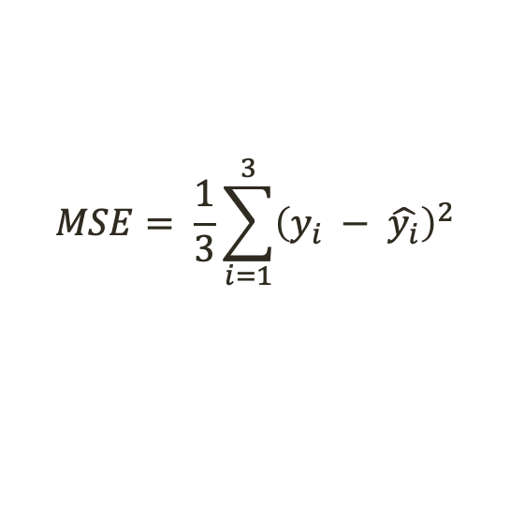

Mean squared error
True response
for the i^{th} observation
We take the average
over all observations
Prediction our model gives
for the i^{th} observation
n = 3
Student | Grade
Ab | 83 | 78
Kaden | 84 | 85
Kylee | 95 | 65
$$MSE= \frac{1}{3}\sum_{i=1}^{3}{{\left(y_{i} − \hat{y_{i}}\right)}^{2}}$$
$$f\left(X\right)$$
$= \frac{1}{3} ({\left(y_{1} − \hat{y_{1}}\right)}^{2}$ + ${\left(y_{2} − \hat{y_{2}}\right)}^{2}$ + ${\left(y_{3} − \hat{y_{3}}\right)}^{2}$)
$= \frac{1}{3} ({\left(83 −78\right)}^{2}$ + ${\left(83 −85\right)}^{2}$ + ${\left(95 −65\right)}^{2}$)
$$=309.67$$

Slide 12
“Training” MSE
This version of MSE is computed using the training data that was used to fit the model
Reality check: is this what we care about?

Slide 13
Test MSE
Better plan: see how well the model does on observations we didn’t train on
Given some never-before-seen examples, we can just calculate the MSE on those using the same method
What if we don’t have any new observations to test?
Can we just use the training MSE?
Why or why not?

Slide 14
Example
Example
Test MSE
Avg. training MSE

Slide 15
Training vs. test MSE
As flexibility ↑:
monotone ↓ in training MSE
U-shape in the test MSE
Fun fact: occurs regardless of data or statistical method
This is called overfitting
Test MSE
Overfitting
Avg. training MSE

Slide 16
Training vs. test MSE
Question: why does this happen?

Slide 17
Trade-off between bias and variance
The U-shaped curve in the Test MSE is the result of two competing properties: bias and variance
Variance: the amount the model would change if we had different training data
Bias: the error introduced by approximating a complex phenomenon using a simple model

Slide 18
Relationship between bias and variance
In general, more flexible methods have higher variance
(Variance: the amount the model would change if we had different training data)

Slide 19
Relationship between bias and variance
In general, more flexible methods have lower bias
(Bias: the error introduced by approximating a complex phenomenon using a simple model)

Slide 20
Trade-off between bias and variance
Expected test MSE can be decomposed into three terms:
The variance of our model
on the test value
The variance
of the error terms
The bias of our model
on the test value
Notes:
We know variance and squared bias are always nonnegative (why?)
There’s nothing we can do about the variance of the irreducible error inherent in the model
So we’re looking for a method that minimizes the sum of the first two terms… which are (in some sense) competing

Slide 21
Balancing bias and variance
It’s easy to build a model with
low variance but high bias (how?)
Just as easy to build one with
low bias but high variance (how?)
The challenge: finding a method for which both the variance and the squared bias are low
This trade-off is one of the most important recurring themes in this course
(Variance: the amount the model would change if we had different training data
Bias: the error introduced by approximating a complex phenomenon using a simple model)

Slide 22
What about classification?
So far: how to evaluate a regression model
Bias-variance trade-off also present in classification
Need a way to deal with qualitative responses
What are some options?
Notes:
So far, we’ve only talked about how to evaluate the accuracy of a regression model
The idea of a bias-variance trade-off also translates to the classification setting, but we need some minor modifications to deal with qualitative responses
For example: we can’t really compute MSE without numerical values, so what can we do instead?

Slide 23
Training error rate
Common approach: measure the proportion of the times our model incorrectly classifies a training data point
and take the
average
where the model’s
classification was different
from the true class
tally up
all the times

Slide 24
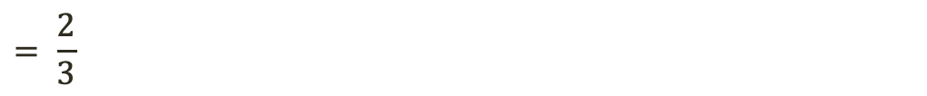
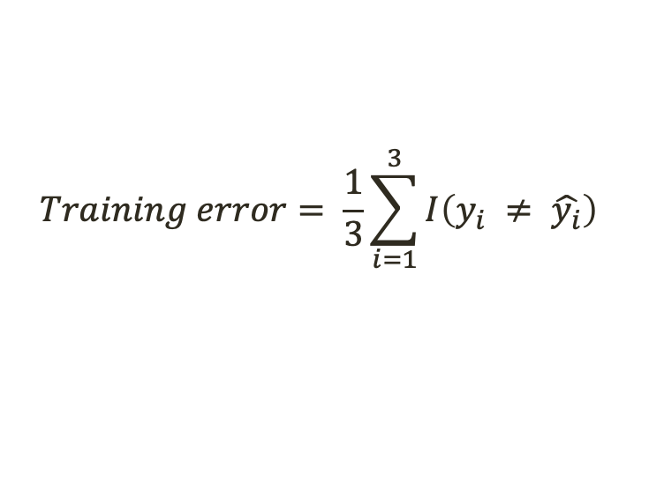

Training error rate
Common approach: measure the proportion of the times our model incorrectly classifies a training data point
and take the
average
tally up
all the times
where the model’s
classification was different
from the true class
n = 3
$$Training error= \frac{1}{3}\sum_{i=1}^{3}{{I\left(y_{i} ≠ \hat{y_{i}}\right)}^{}}$$
Student | Grade
Ab | B- | C+
Kaden | B | B
Kylee | A | D
C$\left(X\right)$
$= \frac{1}{3} ({\left(1\right)}^{}$ + ${\left(0\right)}^{}$ + ${\left(1\right)}^{}$)
$$= \frac{2}{3}$$
$$=0.67$$

Slide 25
Takeaways
Choosing the “right” level of flexibility is critical (in both regression and classification)
Bias-variance trade off makes this challenging
Coming up in Ch. 5:
Various methods for estimating test error rates
How to use these estimates to find the optimal level of flexibility

Slide 26
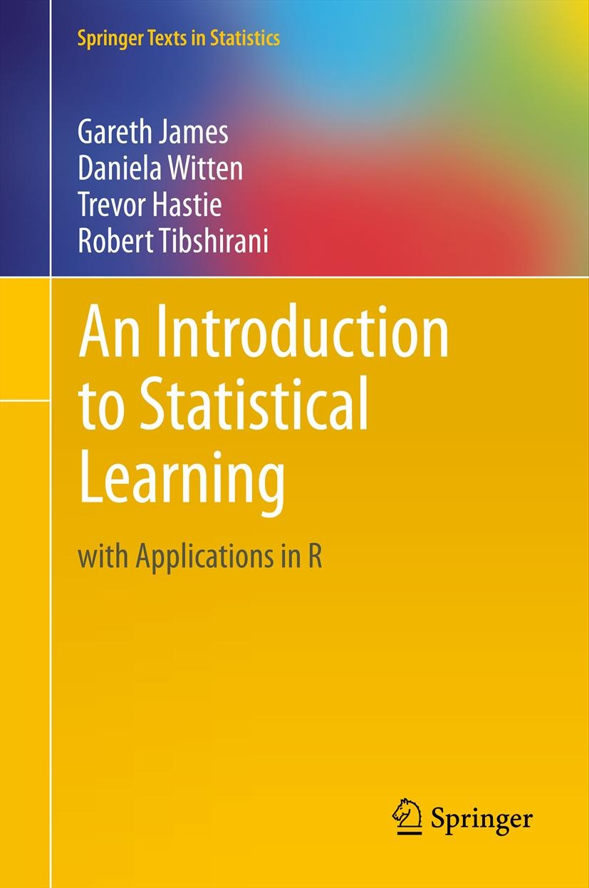
Reading
In today’s class, we covered ISLR: p. 29-37
Next class, we’ll have a crash course in linear regression (ISLR: p. p.59-82)

Slide 27

Introduction to R
Basic commands
Loading external data
Data wrangling 101
Graphics
Generating summaries

Slide 28
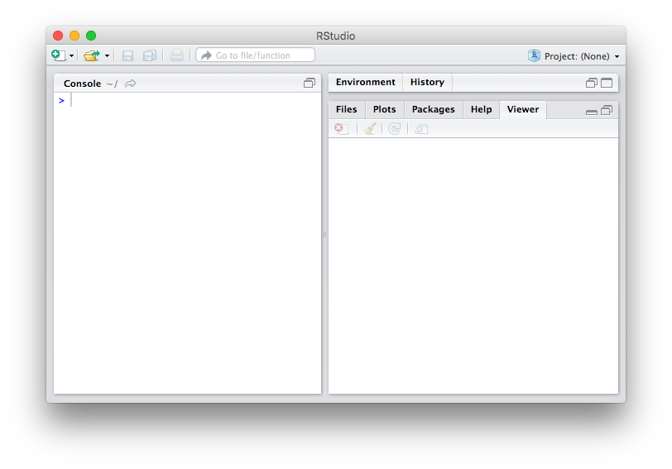
Introduction to R
Notes:
Basic commands
Loading external data
Data wrangling 101
Graphics
Generating summaries

Slide 29

Introduction to R
Today’s walkthrough was run using R Markdown:
This allows me to build “notebooks” to combine step-by-step code and instructions/descriptions

